Slide 1
DIGIRTUPT ExpertConnect – Innovation & Collaboration Report
Notes:
The below and following notes on the template slides are to guide you only. In your final presentation, you may delete these notes and add relevant notes if any.
Title slide:
Title – should not exceed beyond 3 lines, font size 30-34, Arial Headings
(Font size for the title of the PPT can vary between 30-34, Arial Headings, Bold depending on the amount of text, however should not be smaller than 30 font size)
Name should not exceed beyond 1 line, Designation; font size to remain at 18, Arial Headings
Please keep the title slide simple, just the logo, title and name and designation to appear. No other graphic elements or any design, photograph, image can be added to this slide, alignment to remain the same

Slide 2
Agenda
Team – Expert Connect
How we collaborated?
Solution Architecture Implemented
Dependancy Management
Innovations Applied
Notes:
Agenda slide
Heading – Agenda - Font size 30, Arial Headings
Agenda points to be in Arial Body (font size 28)
Please restrict this slide with just 5 agenda points.
If you have more than 5 points on the agenda slide please add another slide.
If you have only 3 then you can use just one slide and delete the other 2 points.

Slide 3

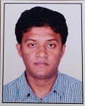
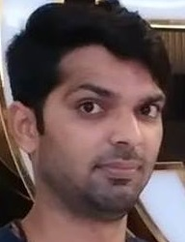
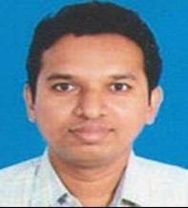
ExpertConnect Team
Sriram Rajagopalan
CTO Office
Sumanta Basu
COMMS - North America, Vodafone Account
Sarav Daman
Product Engineering Services, HP Account
Venkatachalam Subramanian
Talent Transformation

Slide 4
ExpertConnect Team
Each one of our team members(Sriram, Sumanta, Daman and Venkat) is from a different practice/vertical such as CTO, Comms-North America, PES and Talent Transformation.
We came to know each other as part of training programs on DevOps, IoT, Blockchain and Virtual Projects conducted by Venkat, TT.
Once the idea to implement an IoT-Blockchain Solution was formed, Venkat had discussions with the would-be team members individually over coffee, lunch etc. Each one of us enthusiastically joined the Expert Connect team.
Notes:
Content Slide: This is usually the most frequently used slide in every presentation.
Use this slide for Text heavy slides. Text can only be used in bullet points
Title Heading – font size 30, Arial Heading
Slide Content – Should not reduce beyond Arial body font 16
If you need to use sub bullets please use the indent buttons located next to the bullets buttons in the tool bar and this will automatically provide you with the second, third, fourth & fifth level bullet styles and font sizes
Please note you can also press the tab key to create the different levels of bulleted content

Slide 5
How we collaborated
Design discussions were done over webex calls as Daman was in Kolkata and rest of us were in different Towers in EC. Later Daman got transferred to HP Office, ITPL, Bangalore. So, we continued to collaborate over phone calls, webex and Teamviewer.
Apart from the above meetings, we also met on two Saturdays for integrating our work. Once at EC and another time at ITPL.

Slide 6
Solution Architecture
Hive MQTT Broker
(Publish/Subscriber)
IoT Device
MCU (ESP8266-12)+ MQTT client Library
Topic/SensorData
MQTT
Sensors
Topic/ControlData
MQTT
Temp
Humidity
Light Intensity
MQTT
Device Under Control
MQTT
LED
MQTT
MQTT
Blockchain – Node1
Blockchain – Node2
Node JS + MQTT library
Blockchain Shared Ledger &
Smart Contracts on all Nodes
Node JS + MQTT library
Admin/Controller Role
Observer Role
Web-Socket
Web3
Web3
Web-Socket
Web - based Admin Dashboard
Web - based Dashboard

Slide 7
Division of responsibilities
Each one of us took responsibilities as follows:
Sriram – Blockchain
Sumanta – IoT
Daman – Nodejs, MQTT Communication
Venkat – Ideation, Coordination and Collaboration.
All 4 team members were involved in Design and Integration.

Slide 8
Dependency Management
Parallel developments were happening for the 3 modules namely:
Blockchain
Nodejs and MQTT Communication
IoT Device
But each one was dependent on the other modules for testing.

Slide 9
Dependency Management
We identified tools which can be used to simulate the dependant module till it is developed and available.
Tools used:
http://www.hivemq.com/demos/websocket-client/
This is a web based MQTT client. Using this we can Publish MQTT messages and we can also subscribe to MQTT messages.
This tool was used to simulate sensor data (Temperature/Humidity/Lux) from the IoT device to the Blockchain node.
This tool was used to simulate ON/OFF commands from the Blockchain to the IoT device.

Slide 10
Dependency Management
Blockchain Node Application and the Blockchain Smart Contract were developed parallelly. For this the sensor data from IoT device had to be simulated.
An Admin UI was developed to simulate the sensor data from the IoT device.
The above simulations were used to facilitate parallell development by all the developers till integration.

Slide 11
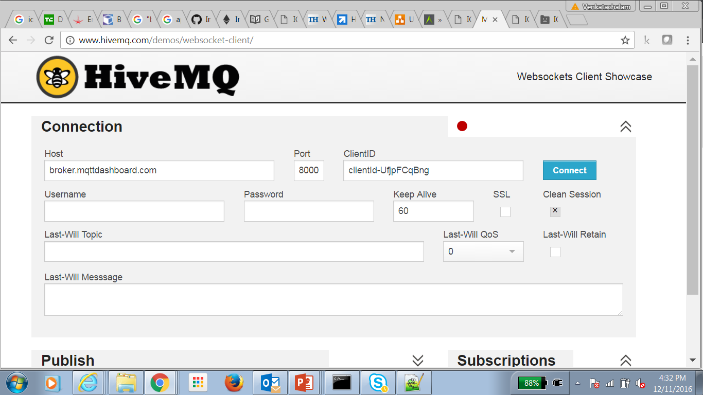
MQTT Client
To simulate MQTT messages carrying IoT sensor data and Blockchain Control data till integration.

Slide 12
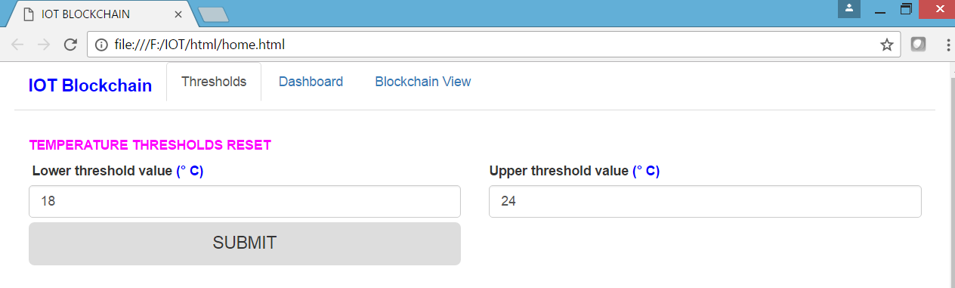
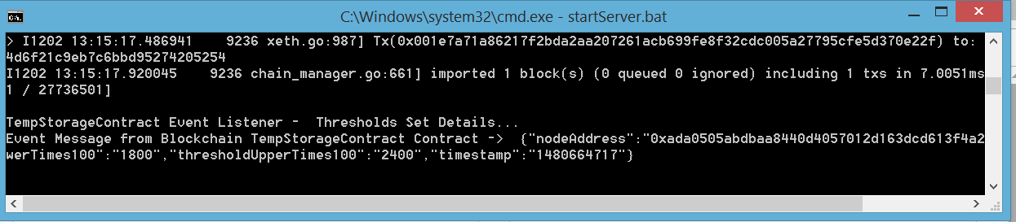
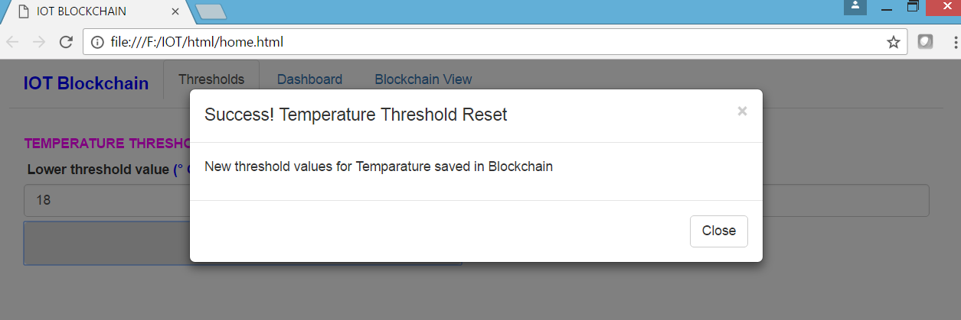
UI to Simulate IoT Sensor Data to Blockchain
Temperature Thresholds Reset
Set Temperature Thresholds from UI
Transaction posted to Blockchain and Event response on Console after storing temperature threshold data in Blockchain (after Mining)
Event response on UI after storing temperature threshold data in Blockchain (after Mining)

Slide 13
Video Recording
Daman used to record the functioning of his working code and send us the video capture of his screens for review.
After integration of all modules, we used the IP WebCam recorder to video record our solution.
This tool helped us to record all parts of our solution on one screen.
Team members travelled to one of our residences where the screen recording and the IoT device LED being controlled was recorded.

Slide 14
Innovations Applied
IoT-Blockchain is an innovation which brings in the benefits of
Immutability of the recorded events(like a blackbox),
Trustability of the smart contract as it cannot be tampered with,
Autonomous control of the real world assets and resources which cannot be unilaterally changed by one party. This can even disintermediate governments if they hesitate to manage a shared resource as per agreements.
Auditability for the regulators
We have used two-way Publish/Subscribe Messaging. Hence we can easily bring in more IoT devices that need to be controlled.

Slide 15
Summary
It was a fantastic work experience where team members from 4 different practices/verticals in different work locations put together extended working hours.
Used multiple collaboration tools such as webex, tcon and Teamviewer to solve a problem.
Dependencies in parallell developments were solved using appropriate tools. They got together whenever needed such as for the video recording.
All done without any formal reporting structure bound by a common goal.

Slide 16
Notes:
Thank you slide with customer logo
Thank you slide with the customer logo:
Should have only the details shown here. Logo placement cannot be changed. Wipro logo to appear on the left as per our corporate guidelines.
Thank you– font size 30, Arial Headings
Name & Designation – font size 18, Arial Headings, not to exceed beyond 2 lines
Your/contact email id – font size 18, Arial Headings

